Slide 1
Final ETCCCP Project
Monitoring the status of the garbage containers
c
ETCCCP Final Project
Group2
22.12.2016

Slide 2
INDEX
01. Introduction & Overview
02. Project Description
03. Pre-Analysis
04. Requirement Specifications
05. Architecture & Design
06. Tests
07. Results
08. Conclusion
09. Demonstration
10. Q&A

Slide 3
01. Introduction & Overview

Slide 4
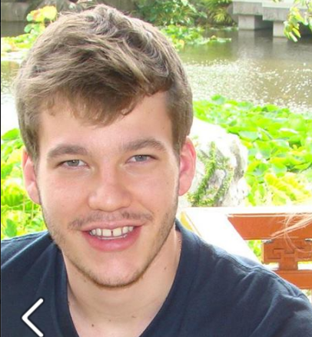

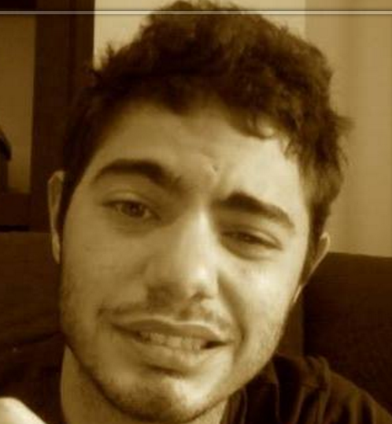
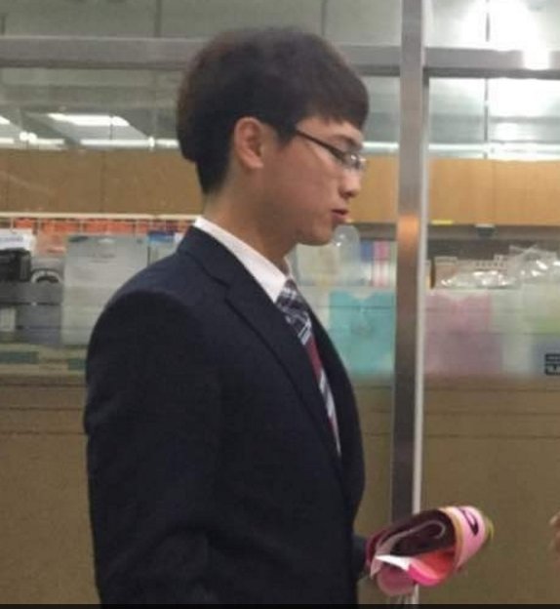
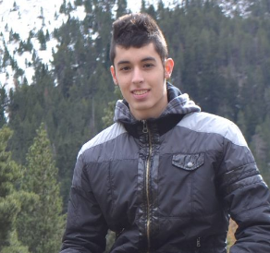

ECCCP Project
01. Intro & Overview
TEAM MEMBERS
Joonas Luukanen
201601318
Pierre Biojoux
201601360
Junyoung Bang
201600883
Xavi Cerqueda Puig
201601224
Bernat Garcia Torrentsgeneros
201600814
Notes:
피피티 배정 소개

Slide 5
ECCCP Project
01. Intro & Overview
Group Agreement Cooperation(AC)
- Project Goal
- Team Goal
- Individual Goal
- Rule
Project Goal
Team Goal
Individual Goal
Rules

Slide 6
ECCCP Project
01. Intro & Overview
Supervisor AC
- Expectations of the supervisor for group
- Expectations of the group for the supervisor

Slide 7
ECCCP Project
01. Intro & Overview
Meeting
- Group meetings
- Supervisor meetings

Slide 8
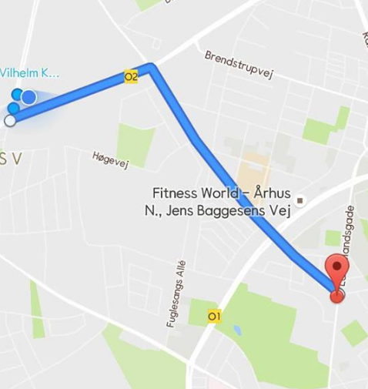


ECCCP Project
01. Intro & Overview
Monitoring the status of the garbage containers

Slide 9
ECCCP Project
01. Intro & Overview
Table of project tasks
Tasks | Quentin Studeny | Pierre Biojoux | Xavier Cerqueda Puig | Bernat Garcia Torrentsgeneros | Joonas Luukkanen | Junyoung Bang
sensor |  |  | X | X
Android Application |  | X |  |  | X | X
Communication 3G/GPRS |  | X | X |  | X
Use Cases |  | X | X
IBD |  | X | X
BDD |  |  |  | X |  | X
Sequence Diagram |  | X | X | X
Project description | X | X | X | X | X | X
Pre-Analysis | X | X | X | X | X | X
Requirement specification | X | X | X | X | X | X
Architecture & Design | X | X | X | X | X | X
Tests | X | X |  | X | X
Project Report |  | X | X | X | X | X

Slide 10
02. Project Description

Slide 11
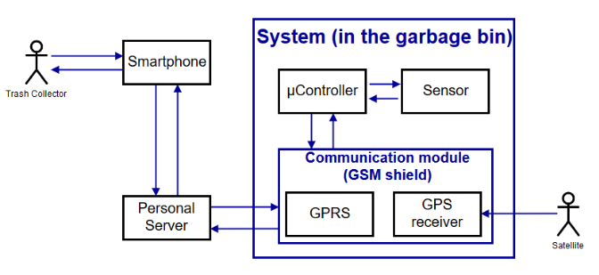
Idea and requirements
ECCCP Project
02.

Slide 12
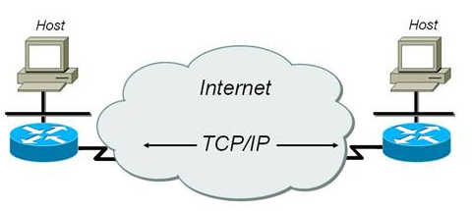


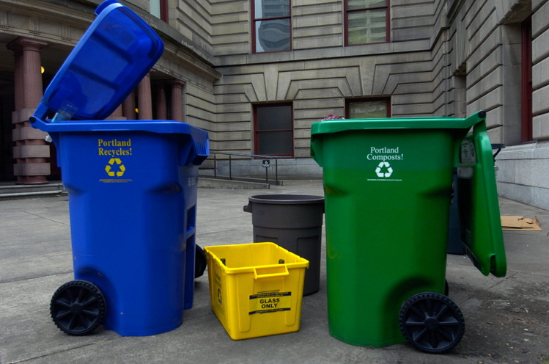
Goals
ECCCP Project
02.
Software
​

Slide 13
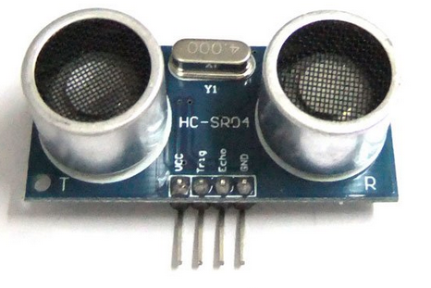
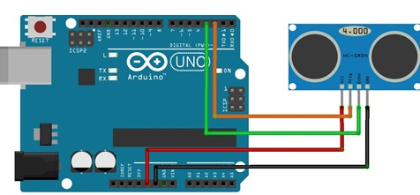
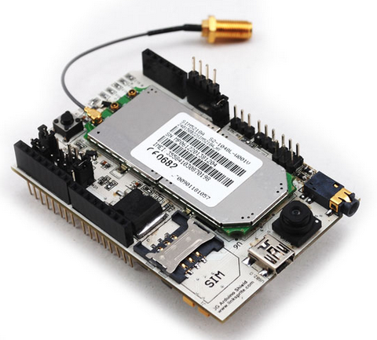
Goals
ECCCP Project
02.
Electronic
​

Slide 14
Why we choose this project?
ECCCP Project
02.

Slide 15
03. Pre-Analysis

Slide 16




Components
ECCCP Project
02.
Sensor
µController
Communication module
Server

Slide 17
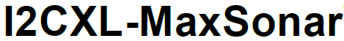
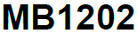
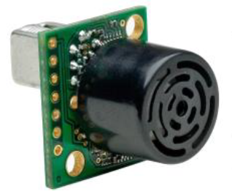
Sensor selection
ECCCP Project
02.
Position switches
Capacitive sensors
Inductive sensors
Photoelectric sensors
Infrared sensors
Ultrasonic sensors

Slide 18
µController selection
ECCCP Project
02.
Platform | Arduino Mega2560 | Arduino Uno | Raspberry Pi ZERO | Raspberry Pi 3 Model B
Microcontroller/ Processor | ATmega2560 | ATmega328P | Broadcom BCM2835 | Broadcom BCM2837
Operating Voltage | 5V | 5V | 5 V | 5 V
Digital I/O pins | 54 (of which 15 provide PWM output) | 14 (of which 6 provide PWM output) | 40-pin GPIO header | 40-pin GPIO header
Flash Memory | 256 KM of which 8 KB used by bootloader | 256 KM of which 0.5 KB used by bootloader | Up to 64 GB | Up to 64 GB
SRAM | 8 KB | 2 KB | 512MB of LPDDR2 SDRAM | 1 GB RAM
Clock Speed | 16 MHz | 16 MHz | 1 GHz | 1,2 GHz
Price | €44 | €19 | €5 | €35

Slide 19
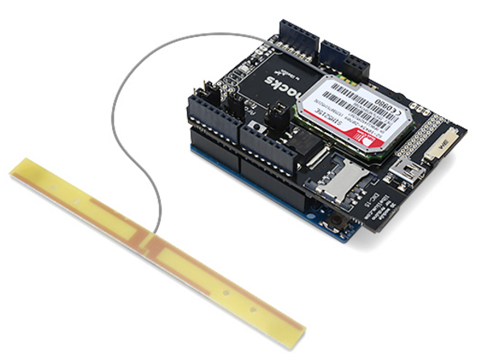
Communication module selection
ECCCP Project
02.
Wi-Fi
Bluetooth
LoRa
3G
GPRS
Cooking Hacks
SIM5215E

Slide 20


Server selection
ECCCP Project
02.
Ubidots
ThinkSpeak
Xively

Slide 21
04. Requirement Specifications

Slide 22
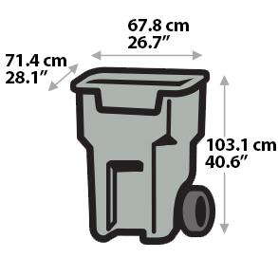
Non-Functional
ECCCP Project
02.
Robustness
Distance
Angle measurement
Notes:
external elements like humidity, collisions, and average but not extreme temperatures (-40 to 85°C)
We have to know the bin is full or not with our ultrasonic sensor. So these sensors must have a range distance from 2cm to 2m. Because of the bin’s size, the sensors maximum should be about 2m.
The angle between the object and the ultrasonic sensor it’s not a problem because the garbage container is filled evenly.

Slide 23
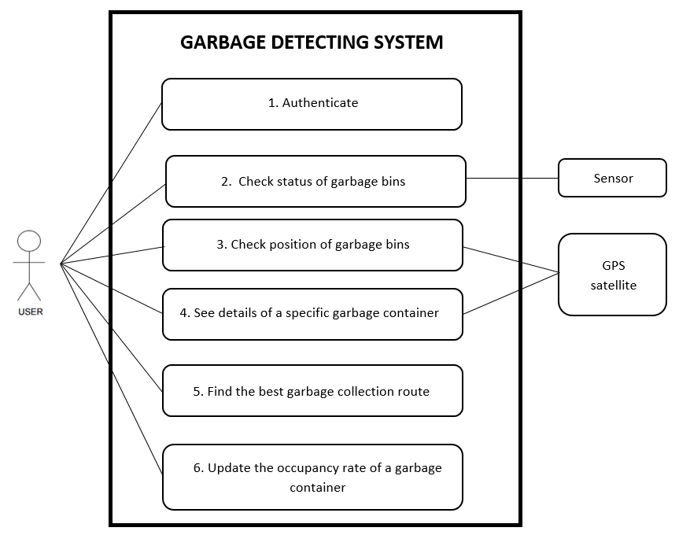
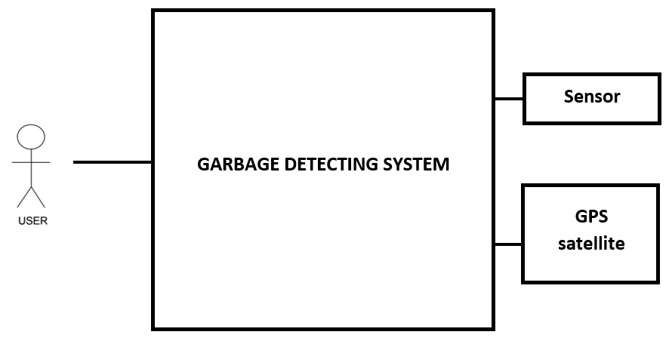
Use Cases
ECCCP Project
02.
Actor Diagram
Use Cases Diagram
Notes:
Define actors
Explain use case diagram
Explain each use case

Slide 24
05. Architecture & Design

Slide 25
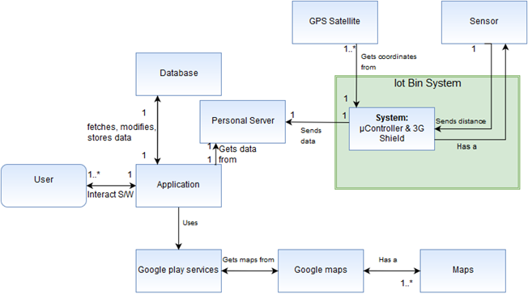
Domain model
ECCCP Project
03.

Slide 26
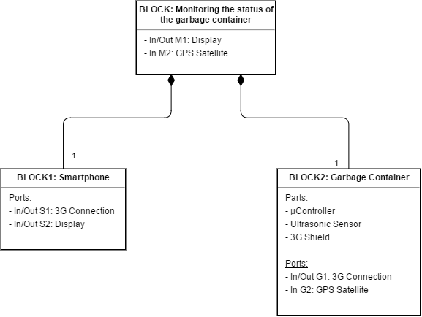
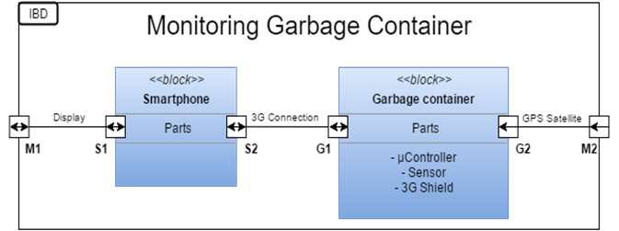
Monitoring garbage container: BDD&IBD
ECCCP Project
03.

Slide 27
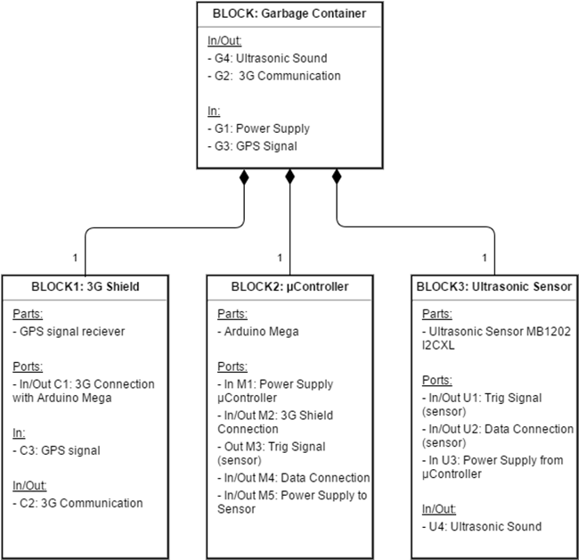
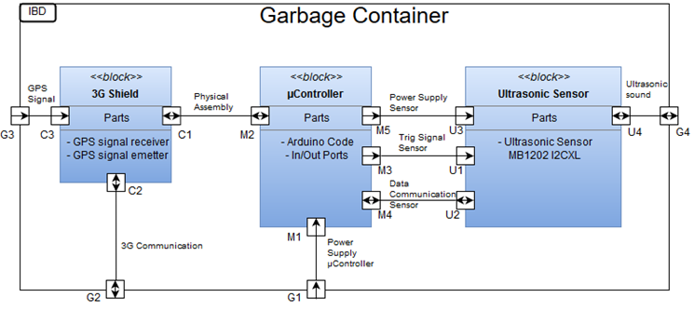
Garbage container: BDD & IBD
ECCCP Project
03.

Slide 28
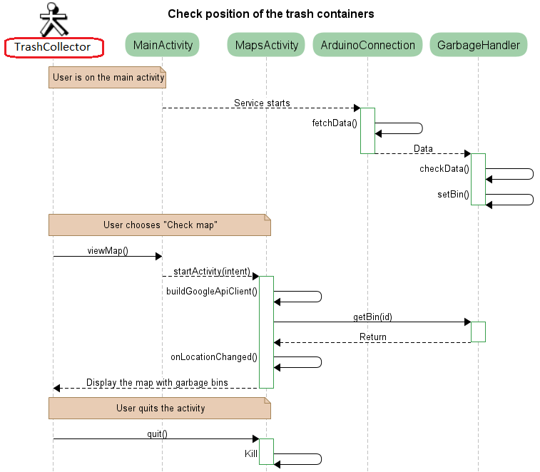
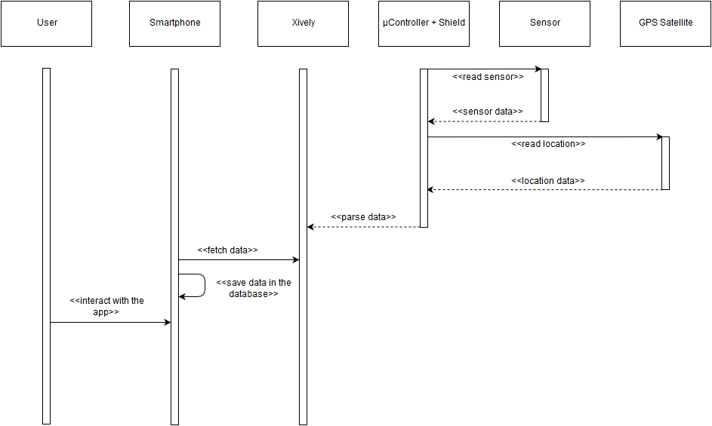
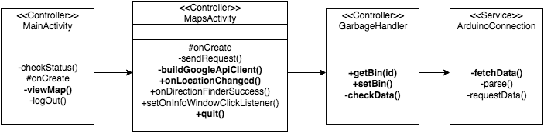
Logical View
ECCCP Project
02.
System Sequence Diagram
Sample Use Case Sequence Diagram
Class Diagram
Notes:
Explain the system sequence diagram
Show the use case 3
Show the class diagram and say it will be more explain by Joonas

Slide 29
Software
ECCCP Project
03.
Android app
-Java
-Android studio
-Github

Slide 30
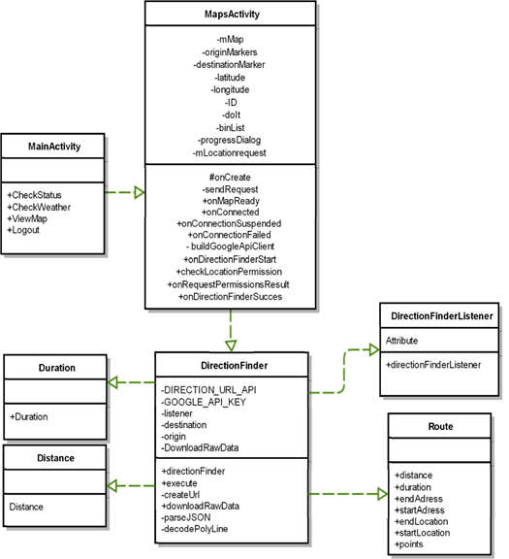
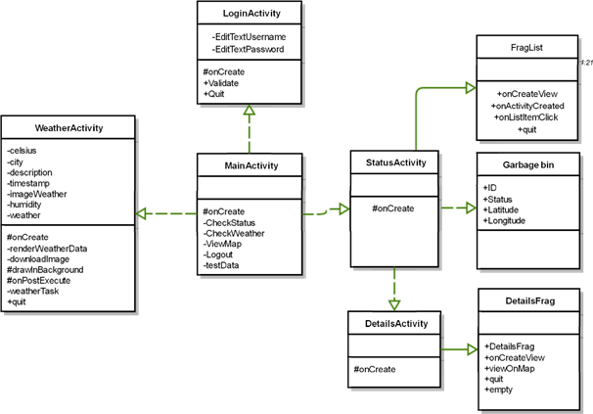
Software
ECCCP Project
03.

Slide 31
Software
ECCCP Project
03.
Activities
-Login
-Main
-CheckStatus
-Maps
Service
ArduinoConnection

Slide 32
Software
ECCCP Project
03.
Android framework
-2 SQLite databases
-Volley
-JSON objects
-Service (Asynchronous)
-Google Maps API

Slide 33
Software
ECCCP Project
03.
Code snippets

Slide 34
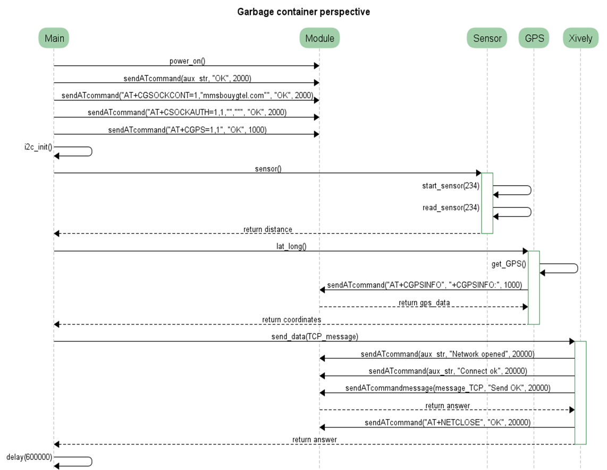
Software
ECCCP Project
03.
Arduino Sequence Diagram
Notes:
Explain the sequence diagram
Explain 3G

Slide 35
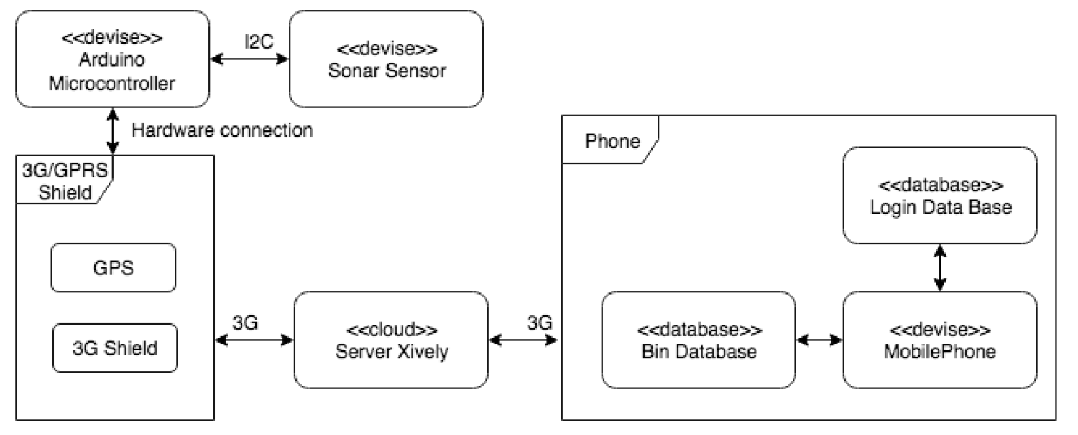
Software
ECCCP Project
03.
Arduino Protocol:
3G Communication
Sensor I2C
Notes:
Explain the sequence diagram
Explain 3G

Slide 36
06. Tests

Slide 37
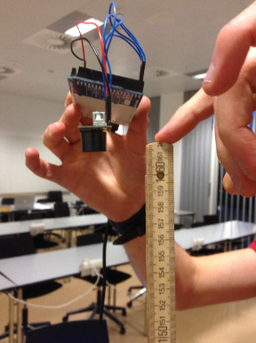
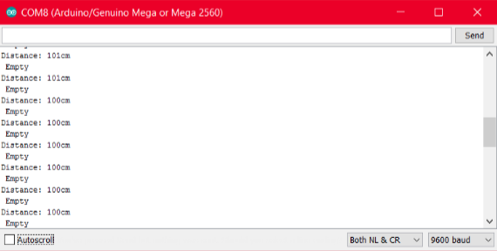
Unit test
ECCCP Project
02.
Sensor

Slide 38
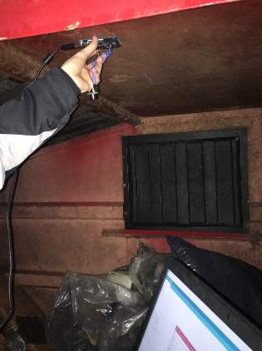
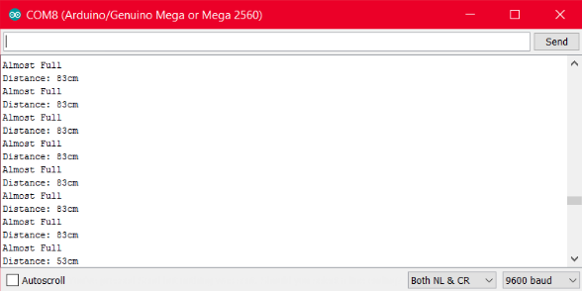
Unit test
ECCCP Project
02.
Sensor

Slide 39
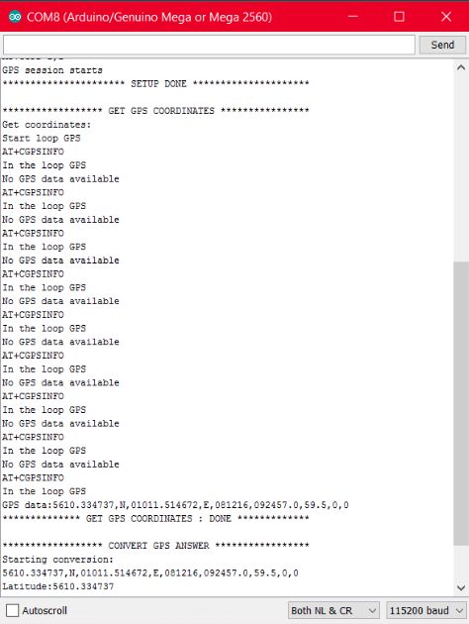
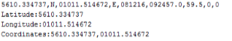
Unit test
ECCCP Project
02.
3G Shield (get location)

Slide 40
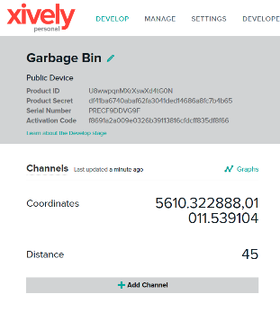
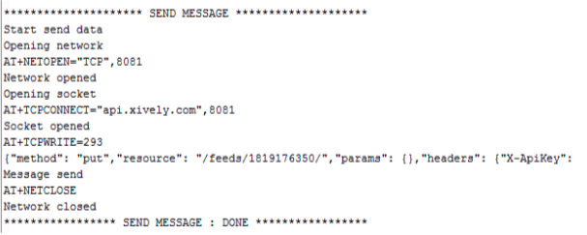
Unit test
ECCCP Project
02.
3G Shield with Server

Slide 41
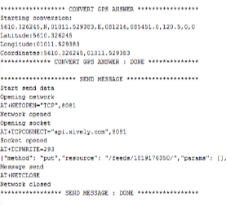
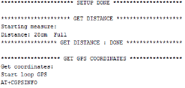
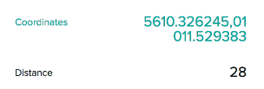
Integration test
ECCCP Project
02.
Sensor,3G Shield with Server

Slide 42
07. Results

Slide 43
Title
ECCCP Project
02.
Description.

Slide 44
08. Conclusion

Slide 45
Title
ECCCP Project
02.
Description.

Slide 46
09. Demonstration

Slide 47
10. Q&A

